Slide 1
Dengue updates
WHO Viet Nam Country Office
22 June 2022

Slide 2
Background
Dengue is an emerging mosquito-borne disease
Global public health threat
Associated with severe disease, large outbreaks, hyper-endemicity, and co-circulation of several serotypes
No specific treatment
Early detection and proper medical care can reduce CFR <1%
Challenges
Underreporting
Climate change
Socioeconomic factors
Serotype interaction
Complicated clinical course

Slide 3
Global Dengue trends 2010 - 2021
100-400 million infections occur every year.

Slide 4
Magnitude in Western Pacific Region
More than 1 million cases in 18 countries in 2019 compared to 385,000 cases in 22 countries in 2013
Case Fatality Ratio: 0.19 in 2019 compared to 0.31 in 2016
Crude annual case incidence rate in WPR: 52.40 per 100,000 population (2019)
All 4 serotypes are present
Number of reported dengue cases and case fatality ratios (2013-2019)

Slide 5
Viet Nam (01 Jan – 18 June 2022)
62,966 cases (80% from Southern region)
37 deaths (97% from Southern region)
Increased by 97% compared to the same period 2021
7.8% increase from the preceding week
50% of deaths were less than 15-year of age
Challenges:
Delay in seeking medical care/referral
Vector control
Human resources
Public awareness

Slide 6
Immediate Responses Recommended
Escalating situation (Cases and Deaths)
Critical areas to be addressed
Early case identification and appropriate clinical management
Referral pathway
Technical capacity of health staff
Monitoring and feedback
Intensive elimination of mosquitoes breeding sites
Public awareness to differentiate with COVID 19
Prevent it before the health system gets overwhelmed

Slide 7
Plan: Mortality review
Clinical panel (both international and national experts)
Review will constitute
Timeline of case management
Disease severity
Fluid management
Result interpretation
Identify cause of death and modifiable factors
Lesson learned and recommendations

Slide 8
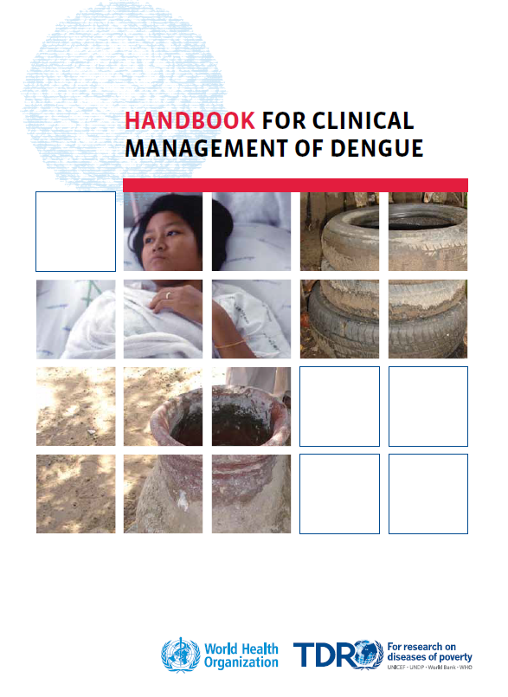
Case management
WHO Handbook for clinical management of Dengue (2012)
Dengue case classification
Referral pathway
Warning signs
Stepwise approach for case management

Slide 9
WHO Key recommendations (2022)
Differentiation of clinical findings among arboviruses and other febrile diseases
Warning signs to identify severe disease
Criteria for hospitalization of dengue patients
Use of intense oral hydration scheme
Use of parenteral hydration for patients with warning signs
Use of crystalloids or colloids
Use of blood components
Drug use for symptoms management
Use of systemic steroids
Use of immunoglobulins

Slide 10
Outbreak response
Action plan
Advocacy to secure political and financial support
Community mobilization, mass media
Vector control
Space spraying/fogging
Larviciding
Environmental management
Identify priority areas for dengue risk-reduction activities
Identify priority areas for fogging activities

Slide 11
Outbreak response Con:
Disease surveillance
Capacity building of health staff on case detection, case management, case referral
Prepare for health services management (e.g. mobilization of health staff)
Collaboration with key partners
M&E

Slide 12
Medium and longer term
Vector control
Vector surveillance based on epidemiological data
Year-round source reduction (e.g. construction sites, dump yards, etc.)
Insecticide resistance monitoring
Strengthening diagnostics and case management
Capacity building of health staff
Promote community engagement and increase public awareness
Novel vector control strategies (e.g. Wolbachia)
Strengthening implementation research to identify and further improve the response for dengue outbreak
Strengthening coordination and regular sharing of information among partners

Slide 13
References
WHO prequalification list of vector control products
https://extranet.who.int/pqweb/vector-control-products/prequalified-productlist?field_product_type_tid=All&field_pqt_vc_ref_number_value=&title=&field_applicant_tid=&field_active_ingredient_synergis_tid=
WHO Handbook for clinical management of Dengue (2012)
https://www.who.int/publications/i/item/9789241504713
WHO Guidelines for clinical diagnosis and treatment of Dengue, Chikungunya and Zika (2022)
https://iris.paho.org/bitstream/handle/10665.2/55867/9789275124871_eng.pdf?sequence=1&isAllowed=y
Thank you

